Slide 1
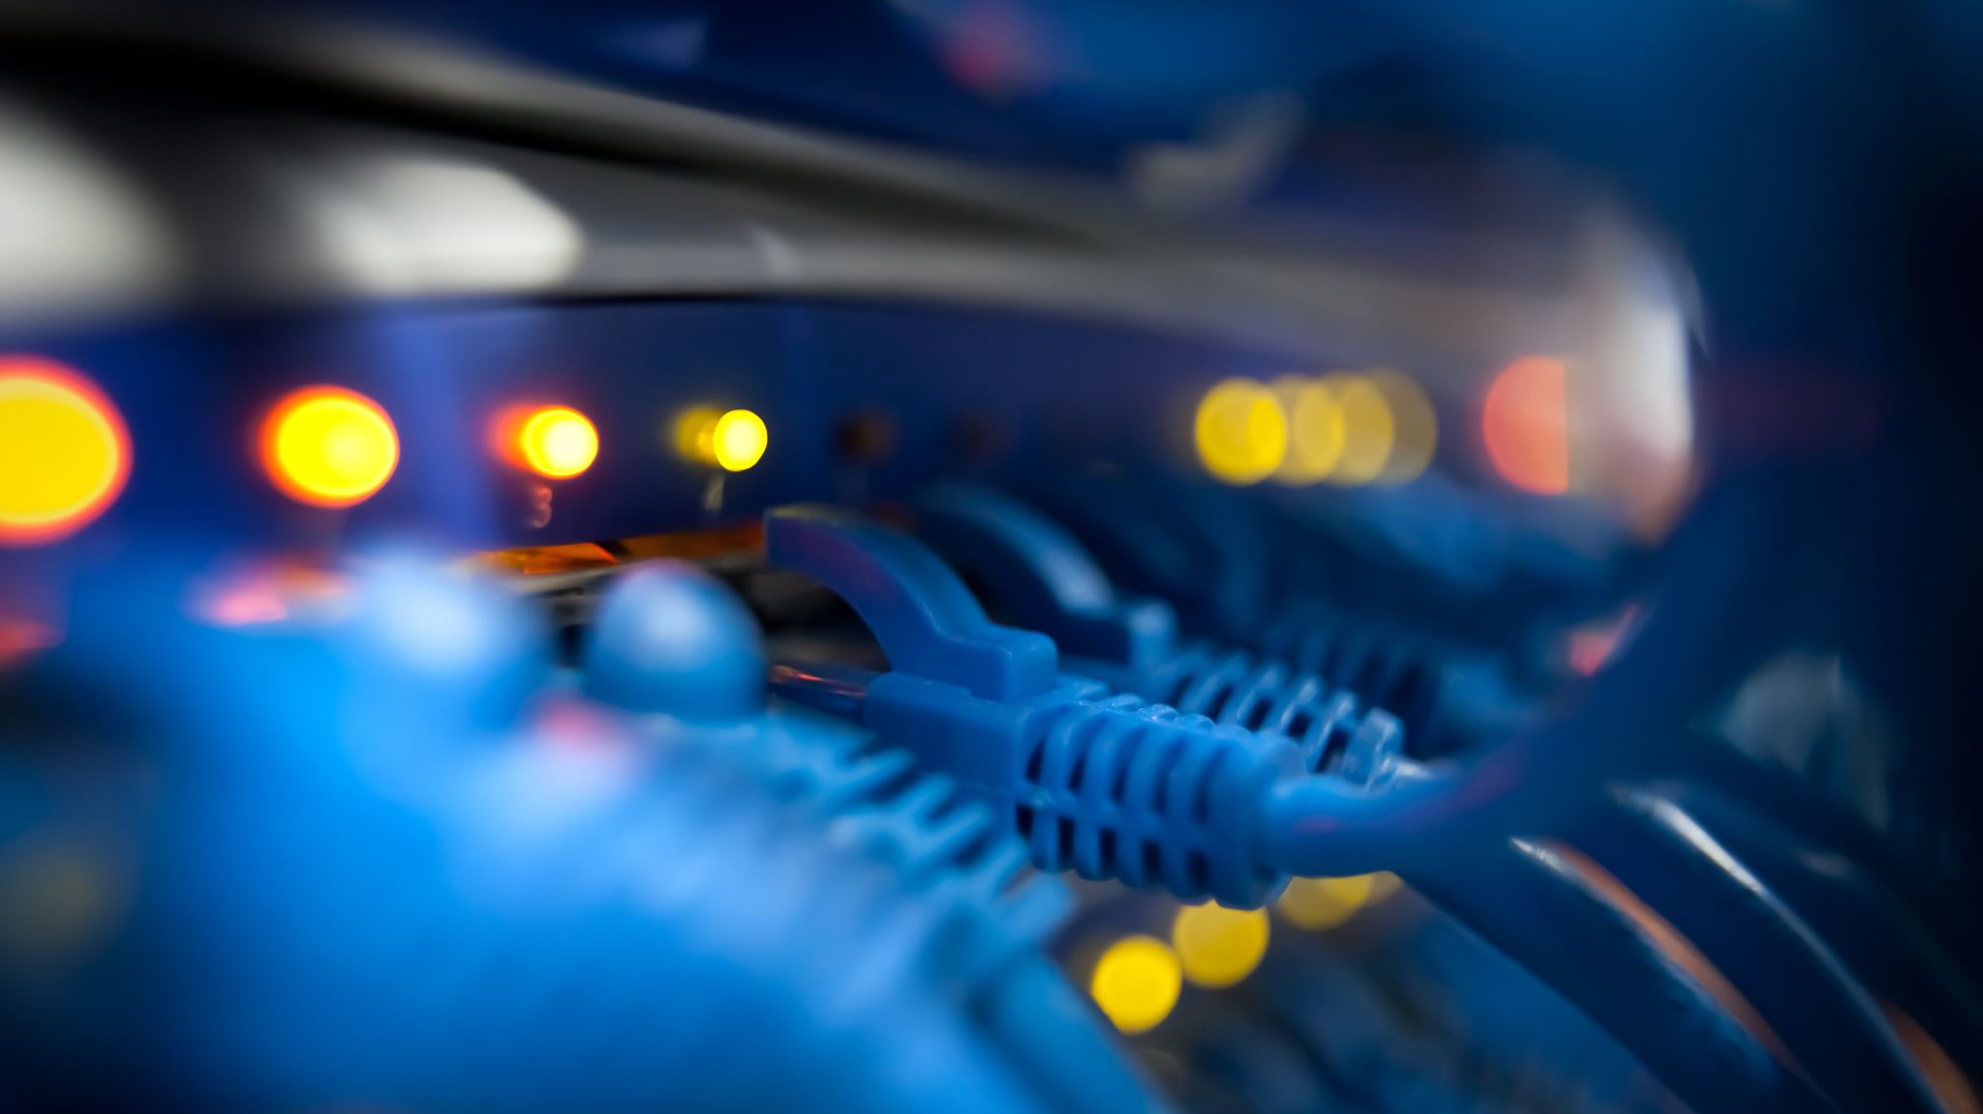
INTRODUCTION TO THE NETWORK ADMINISTRATOR: NETWORKING BASICS

Slide 2
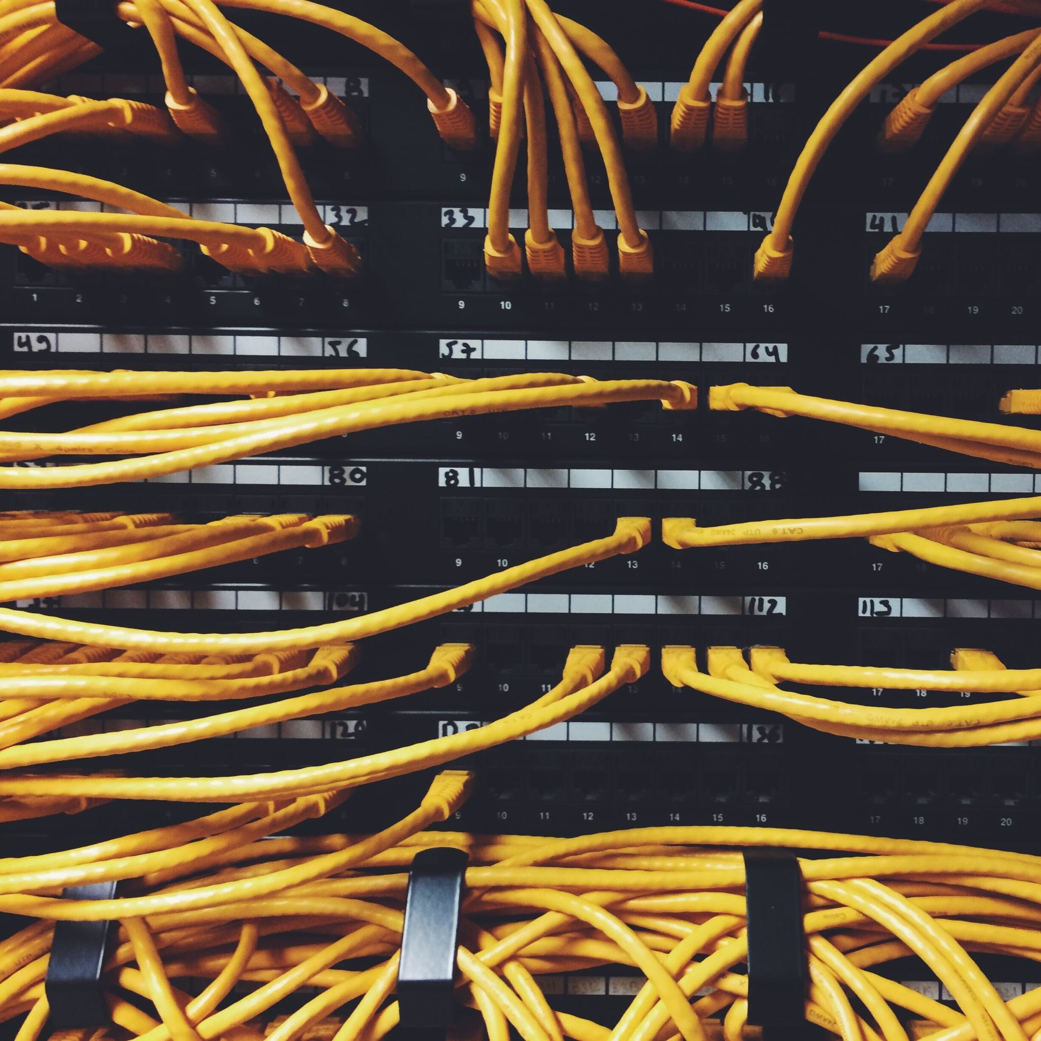
What Is a Network Administrator?
A network administrator is an IT professional who ensures that an organization’s computer networks, and telephony services are operating to meet the needs of the organization.
They can maintain and troubleshoot computer networks and employ security principles to keep networks secure.

Slide 3
What does a network administrator do?
Install, configure, and maintain network hardware and software such as routers, firewalls, and switches
Protect networks from unauthorized users through physical and technical means
Set up and maintain virtual private networks (VPN)
Resolve network connectivity issues for other employees
Maintain and troubleshoot storage networks

Slide 4
Key network administrator skills
Knowledge of different types of networks: Local Area Networks (LANs), Wide Area Networks (WANs), Virtual Private Networks (VPNs), and sometimes Storage Area Networks (SANs) are each different types of networks.
Understanding of network security components: These might include firewalls, VPNs, and access control.
Communication and teamwork: As a network administrator, you’ll likely be working in a team or with other members of your organization to ensure computers and systems are up and running. Being able to communicate problems and solutions with other people is a valuable skill to have.
Having a foundational knowledge of what various networks are and how to configure them will be central to your work as a network administrator.

Slide 5
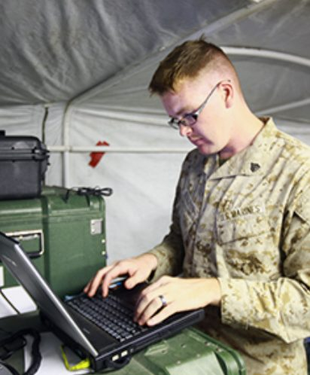
0631 – Network Administrator MOS
Network Administrators install operate and maintain Local Area Networks (LAN) and Wide Area Networks (WAN) to enable command and control. Typical duties include routing/switching configuration, premise wiring and installation of network components.
Additional responsibilities include, network monitoring and Quality of Service (QOS) to maintain adequate bandwidth utilization in support of communication networks and data services.
Marines will be familiar with routing protocols, Virtual Private Networks (VPN), Internet Protocol Security (IPSEC), traffic monitoring, and cybersecurity.

Slide 6

Questions

Slide 7

What is a Network?
A network is a collection of computers and other hardware interconnected by communication channels that allow sharing of resources and information.
It is a group of devices connected to each other
Networks can be classified into a variety of characteristic, such as the medium used to transport the data, communications protocol used, scale, topology, benefit, and organizational scope.

Slide 8
Types of Networks
Local Area Network (LAN)
A LAN is a network that interconnects computers in a limited area such as a home, school, computer lab, or office building.
Wide Area Network (WAN)
A WAN is a network that covers a broad area such as telecommunications networks that link across regional or national boundaries

Slide 9
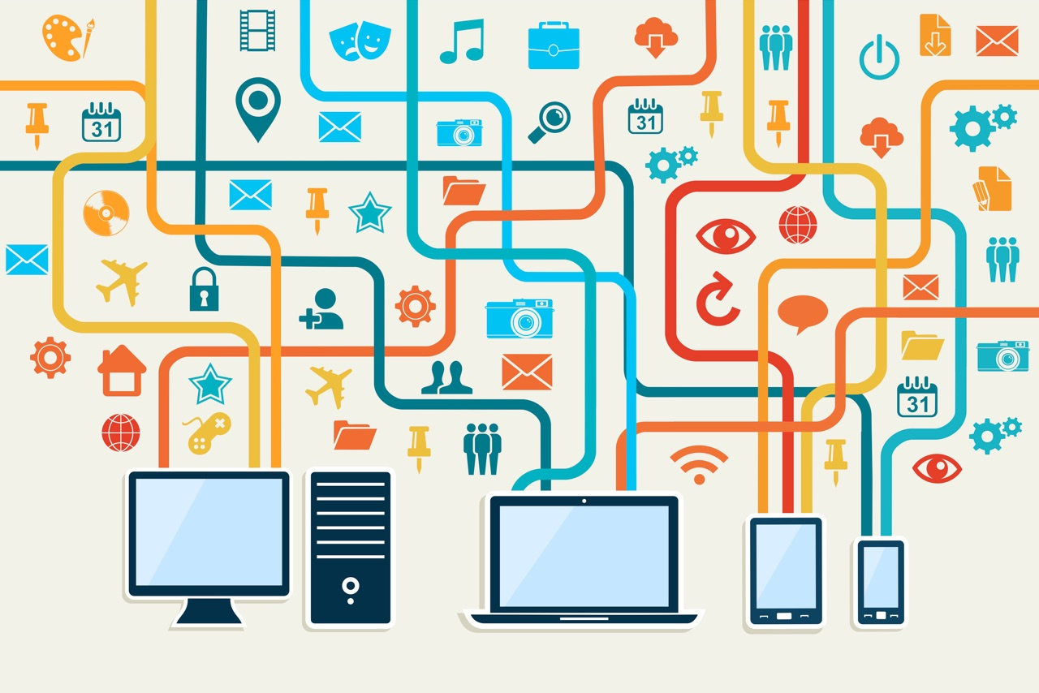
Network usage
Networks are used for a number of reasons, one way or another it’s usually about sharing:
Information: we use networks for applications like e-mail or to reach certain websites.
File sharing: we need a network so that users can reach a shared network drive with documents, pictures and/or other files.
Resource sharing: we can connect a printer to the network that is used by multiple users. No need to connect a printer directly to each computer.
Application sharing: we might have users that require access to the same application. For example, a finance department with five users that need access to the same bookkeeping software.
A network can be as small as two computers that are directly connected to each other or as large as the Internet with millions of devices.

Slide 10
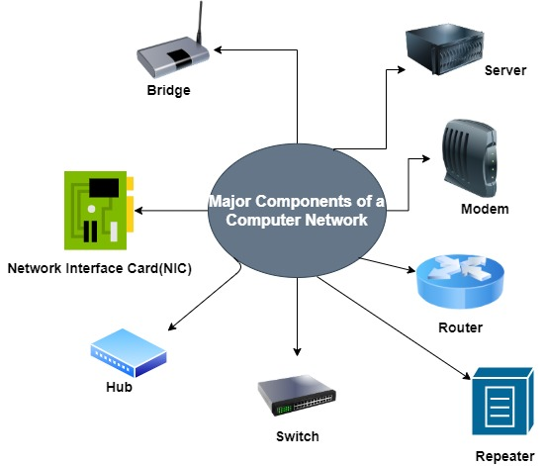
Network Hardware
To build a network, there are some devices that we need.
Host Devices
Servers
Network interface cards
Communication links
Switches
Routers
firewalls

Slide 11
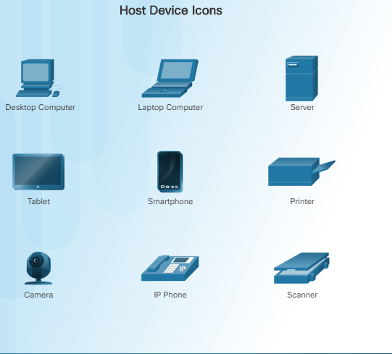
Host device
Host devices are the devices that are used by end users. A decade ago, we mostly used desktop computers but nowadays we have laptops, VTC’s, VoIP, printers etc.

Slide 12
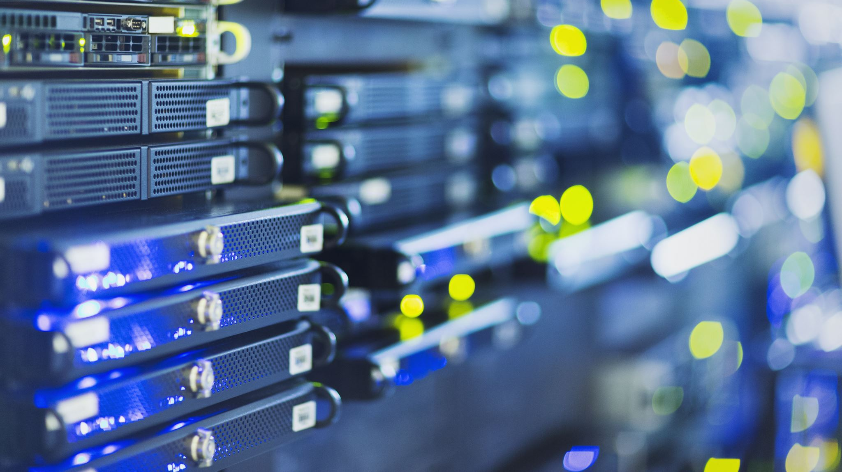
Servers
Servers are similar to computers but have a different role in the network.
For example, when you check your e-mail your client is connecting to an e-mail server to fetch your e-mail.
This email server might be used by thousands of users so it has to be available 24/7.
Servers use similar hardware as what you will find in computers but depending on their task, are more reliable.
They have more RAM (memory) with error correction, use hard disks that were designed to be always-on, have more storage space and so on.

Slide 13
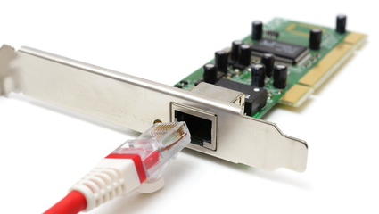
Network Interface Card
To connect our computers and servers to a network, there has to be some interface.
We use NICs (Network Interface Card) for this.

Slide 14
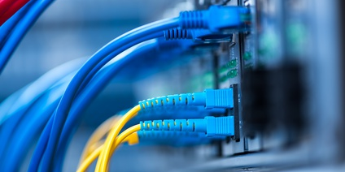
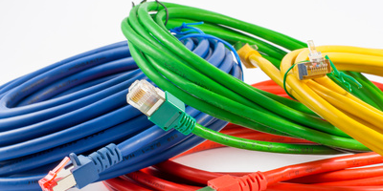
Communication links
There are different types of communication links and cables.
On your local network, you probably have seen RJ-45 UTP(Unshielded Twisted Pair) cables before .
For Internet connectivity, you might use RJ-11 DSL which uses the phone line from the telco, or perhaps you have cable Internet access which uses the COAX cable like your TV.
For long distance links, a lot of fiber cable is used.

Slide 15
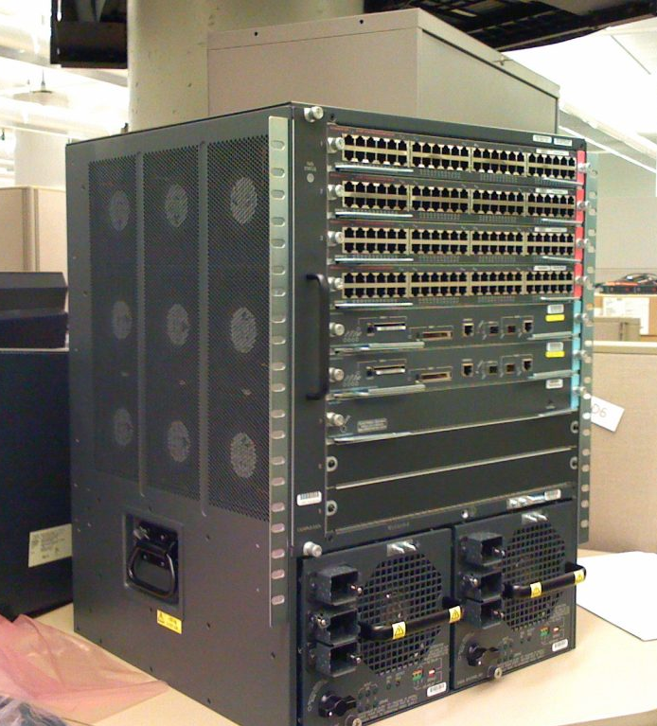
Switches
On local networks we typically use switches to connect computers and servers to the network, allowing them to communicate with each other.
These switches can be as small as something you might find at home or at a small company network.
In large enterprise networks, you might find big switches that offer hundreds of connections for computers and servers.

Slide 16
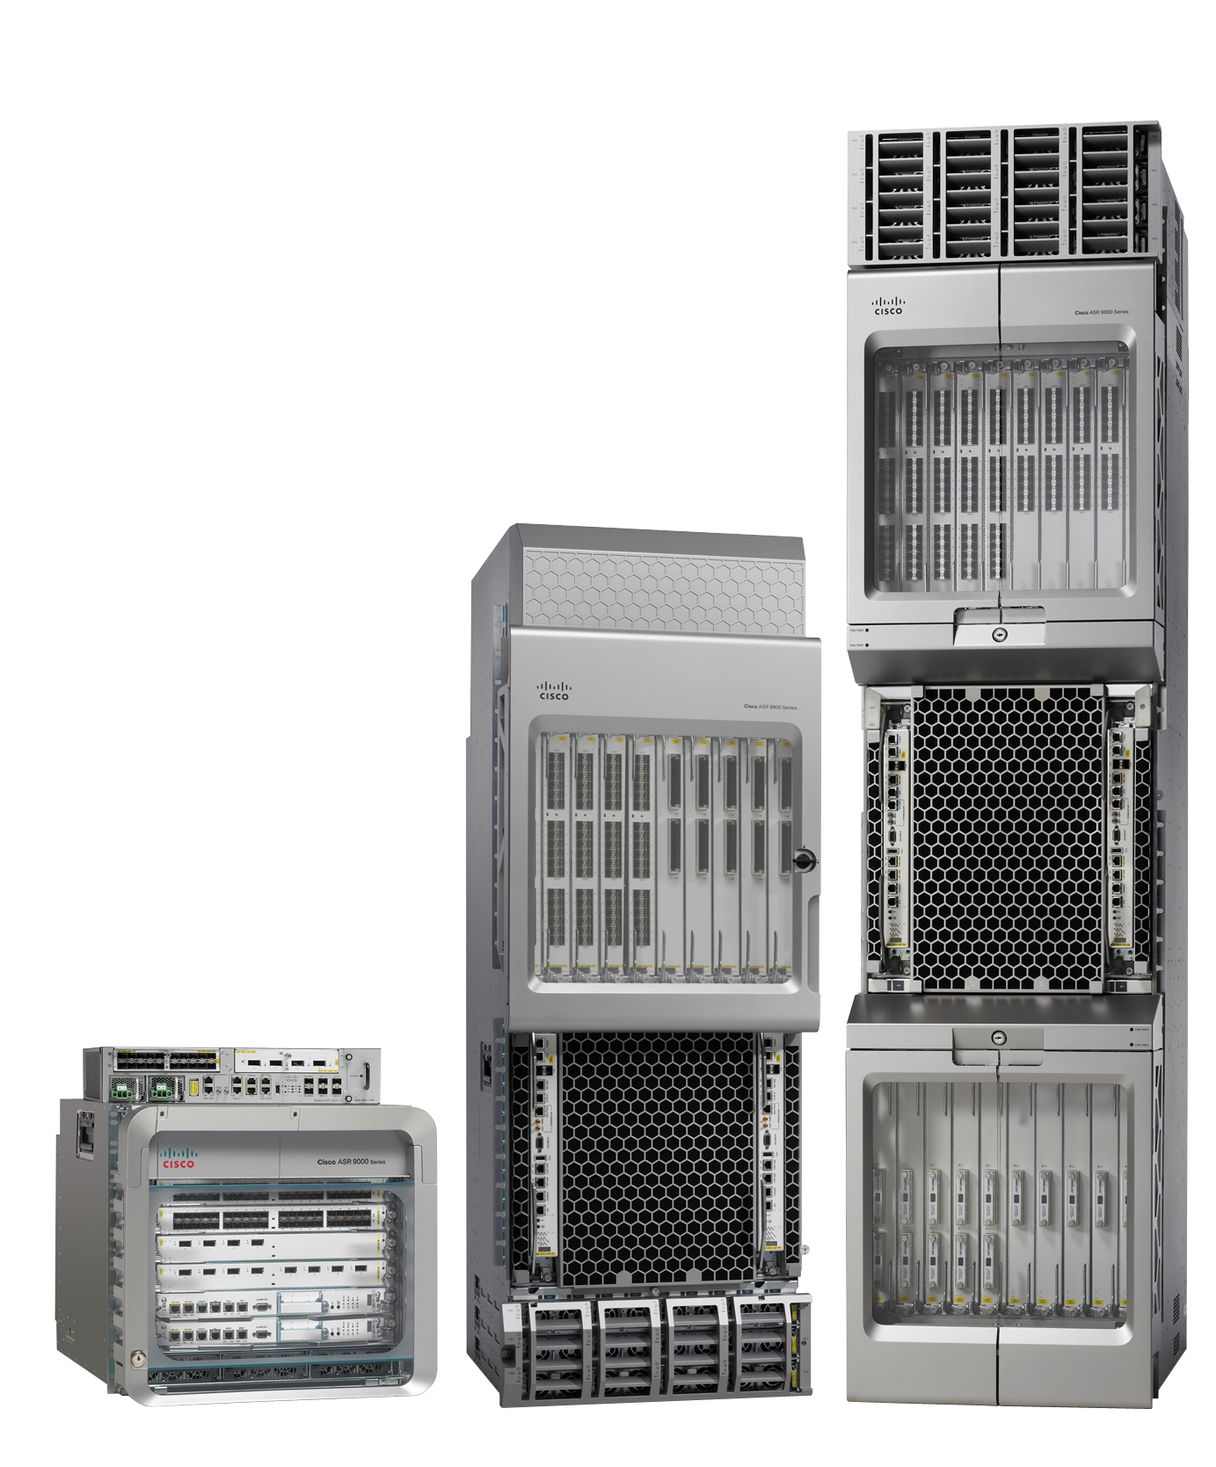
Routers
Routers are used for a number of reasons.
The main reason is that they figure out what path to use to get to a certain destination.
For example, you might live in New York but the e-mail server you use to check your e-mail is located in Los Angeles.
Just like there are many different roads to take if you want to drive from New York to Los Angeles, there are many different network paths to take in order to send our network traffic from A to B.
By exchanging information about networks between different routers, we are able to calculate a path to get to each destination.
Routers can be as small as something we use at home or at a small business, or as big as the routers that are used by Internet providers like AT&T that handle a lot of traffic.

Slide 17
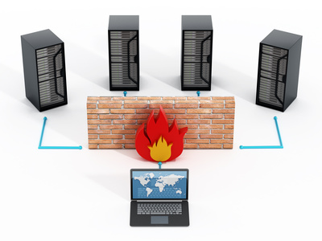
Firewalls
In a perfect world, we could trust everyone and we don’t have to worry about security.
Unfortunately, besides all the great things the Internet offers us there is also a lot of malicious stuff. Think of viruses, malware, and hackers.
Firewalls are used to inspect network traffic and drop malicious traffic.
We also use them to encrypt network traffic so that remote workers can access applications on the company network in a secure way.

Slide 18
Networking Tracks
Routing and Switching
Everything I described above so far falls under routing & switching. This is about connectivity. Connecting devices like computers or servers together using routers and switches, getting network traffic from A to B.
Voice over IP
Originally, computer networks were built only for data traffic and we used phone cables for telephony. Nowadays, we also use the same data network for telephony with VoIP (Voice over IP).
We use IP phones that are connected to the network and a digital telephony system with calling rules. We also have to make sure that voice traffic gets preference on the network or you end up with poor audio quality.
Wireless
Not too long ago, most networks only had desktop computers with wired connections. Nowadays, a lot of users enter the office with a laptop, smartphone, and tablet, expecting connectivity for all these devices. Wireless networking means you have to understand how data is transmitted and received using radio waves and how to build a network that supports dozens of wireless users using hardware like access points and wireless controllers.

Slide 19
Networking Tracks Cont.
Data Center
A data center is a facility that houses up to thousands of servers. There’s air conditioning, it’s dust free, fire suppression and everything else to ensures these servers stay up and running. These servers might be used by millions of users all over the globe. The networking equipment that is used to connect all these servers has different requirements compared to your average office network.
Security
Network security covers a lot of different topics. Here are some of the things we have to deal with:
Monitor network traffic, making sure no malicious attackers are able to enter our network.
Block malicious traffic using network devices like a firewall.
Encrypt traffic between different networks using VPNs.
Authenticate users before they get access to the network.
Create security policies and ensure they are enforced.

Slide 20

Questions

Slide 21
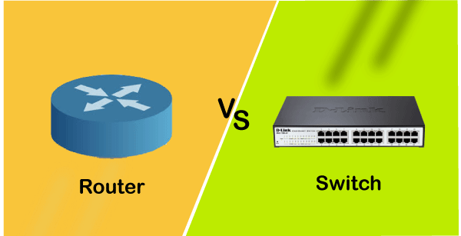
Introduction to Routers and Switches

Slide 22
Routing and switching are the two main functions of a network.
Their purpose is to connect the different segments of your network infrastructure.

Slide 23
Switching Basics
Network switches are used to connect computers and servers to a single network.
The switch performs the function of a controller and allows the devices within a network to communicate with each other.
This action is performed through packet switching, where data is received, processed, and forwarded to its destination from one computer to another.

Slide 24
Routing Basics
While switches connect computers within a single network, routers are used to connect entire networks to each other.
Data packets are received, processed, and forwarded from one network to another.
Routing allows computers to link through the internet, thus allowing for information sharing between different networking systems.

Slide 25
What’s the difference?
Switching creates a single network made up of individual computers, routing connects entire networks to each other.
Switches recognize mac-addresses whereas routers recognize ip addresses
Routers perform a role similar to that of switches, but on a much larger scale.
Thus, a router essentially acts as a dispatcher of data through the most efficient channels between networks.

Slide 26
Questions

